Slide 1
Computer Network Fundamentals

Slide 2
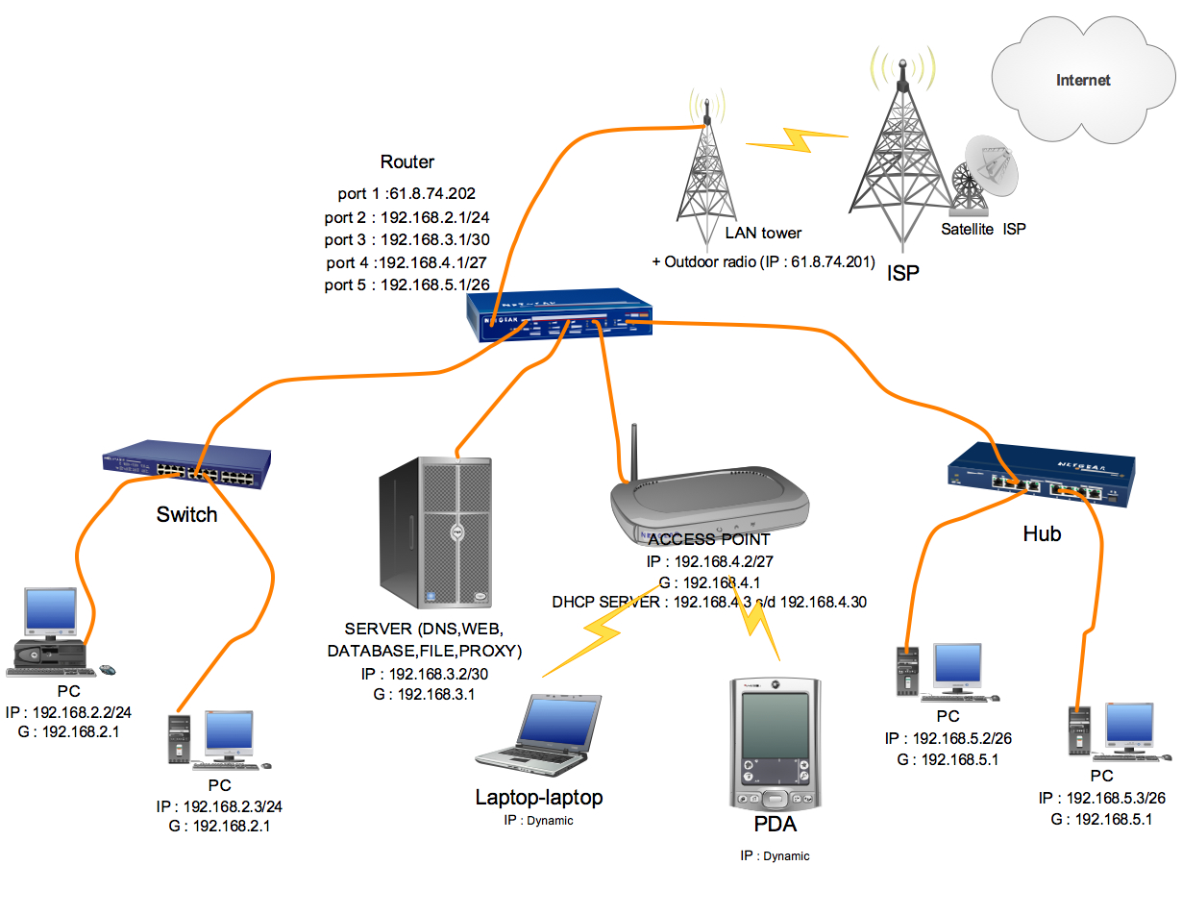

Slide 3
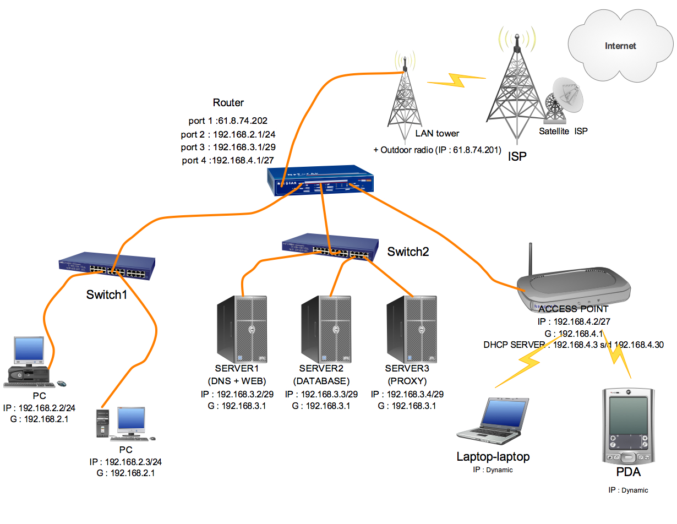

Slide 4
Network Protocols (review)
In the area of computer communication, a Protocol is a formal set of rules that describe how computers transmit data and communicate across a network.
The Protocol defines the message format and the rules for exchanging the messages.
This allows a computer to receive a series of 1s and 0s and to be able to interpret them into something meaningful.

Slide 5
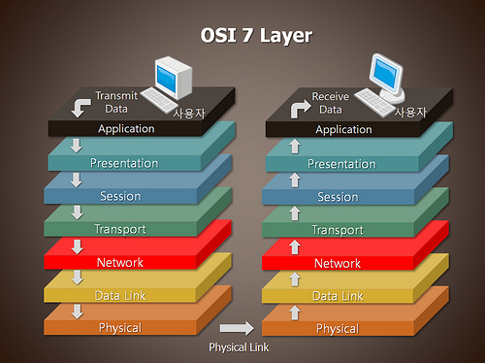

Slide 6
OSI Layers
Layer | Function | Protocols or standards
Layer 7 : Application | Provides services such as e-mail, file transfers, and file server | HTTP, FTP, DNS, TFTP, SMTP, SFTP, SNMP, Rlogin, MIME
Layer 6 : Presentation | Provides encryption, code conversion, and data formatting | MPEG, JPEG, TIFF
Layer 5 : Session | Negotiates and establishes a connection with another computer | SQL, X-Window, ASP, DNA SCP, NFS, RPC.
Layer 4 : Transport | Support end-to-end delivery of data | TCP, UDP, SPX
Layer 3 : Network | Performs packet routing across network | IP, OSPF, ICMP, RIP, ARP, RARP
Layer 2 : Data Link | Provide error checking, and transfer of message frames | Ethernet, Token Ring, 802.11
Layer1 : Physical | Interfaces with transmission medium and send data over the network | EIA RS-232, EIA RS-449, IEEE 802

Slide 7
OSI Layers : Application Layer
The Application Layer, is the interface to user and provides services that deal with the communication portion of an application.
Protocols associated with application layer include the following :
File Transfer protocols (FTP) – provides for authenticated transfer of files between two computers and accessing directories.
Trivial File Transfer Protocol (TFTP) – Reduced version of FTP (does not provide authentication or accessing of directories)
Domain Name Service (DNS) – A distributed database system that matches host name to IP address. A popular DNS implementation is BIND

Slide 8
OSI Layers : Application Layer
Simple Mail Transfer Protocol (SMTP) – Support the transmission and reception of e-mail
Secure File Transfer Protocol (SFTP) – SFTP is a client that similar to FTP and uses SSH or SSH-2 to provide secure transfer.
Simple Network Management Protocol (SMNP) – support the exchange of management information among network devices through a management entity that polls these devices.
Remote Login (Rlogin) – a command in UNIX that begins a terminal session between an authorized user and a remote host on a network. Rlogin is similar to telnet command.
Multipurpose Internet Mail Extensions (MIME) – enables to use of non-US-ASCII textual messages, non textual messages, multipart messages bodies, and non-US-ASCII information in message headers in Internet mail.

Slide 9
OSI Layers : Presentation Layer
Presentation Layer performs encryption, decryption, compression and decompression function, as well as translating codes such as Extended Binary-coded Decimal Interchange Code (EBCDIC) or American Standard Code for Information Interchange (ASCII)
Standards associated with layer 6 include the following :
Motion Picture Expert Group (MPEG) – The Motion Picture Expert Group standard compression and coding of motion video
Joint Photographic Expert Group (JPEG) – Standard for graphics defined by the Joint Photographic Expert Group
Tagged Image File Format (TIFF) – A public domain raster file graphics format. TIFF is platform independent and was designed for use with printers and scanners.

Slide 10
OSI Layers : Session Layer
Session layer provide services to transport layer, to support application.
The function of layer 5 are summarized as follow :
Establishing the connection
Transferring data
Releasing the connection
Session layer protocols include the following :
Structure Query Language (SQL) – an application that support multiple to SQL database.
X-Window System – Support developing graphical user interface application
AppleTalk Session Protocol (ASP) – use to set up a session between an ASP server application and an ASP server workstation application process.
Network file System – Supports the sharing of files among different types of file system

Slide 11
OSI Layers : Transport Layer
Transport Layer maintains the control of a communications session.
In essence, the transport layer interfaces and prepares the application data to be sent across the network.
The protocols are as follow :
Transmission Control Protocol (TCP) – A highly reliable, connection-oriented protocol used in communication between host in packet switched computer networks or interconnected networks.
User datagram Protocol (UDP) – UDP is not guaranteed delivery packets on a best effort basis. It does not provide error correction.

Slide 12
OSI Layers : Transport Layer
There are three cases in which UDP preferred :
Real Time Communication
Repetitive information
Excessive overhead
Sequenced Packet Exchange (SPX) - A protocol maintained by Novel, Inc. It use the Internet Packet Exchange (IPX) protocol to transmit and receive packets.

Slide 13
OSI Layers : Network Layer
This layer provides switching and routing technologies, creating logical paths, known as virtual circuits, for transmitting data from node to node.
Routing and forwarding are functions of this layer, as well as addressing, internetworking, error handling, congestion control and packet sequencing.
Network layer perform the following function :
Switching and routing
Forwarding
Addressing
Error detection
Node traffic control

Slide 14
OSI Layers : Network Layer
The protocols include :
Internet Protocol (IP) – provide a best effort or unreliable services for connecting computers to form a computer network. A computer on the network is assigned a unique IP address.
Open shortest path first (OSPF) – a routing protocol that routers use to exchange information on they are connected together.
Internet Control Massage Protocol (ICMP) - Carries IP error and control messages. ICMP Echo Request ; Test route to a particular host. Live host should reply with ICMP Echo Reply packet.
Routing information Protocol (RIP) – it is also routing protocol but it is not as popular or widespread use because it is not as efficient as OSPF.

Slide 15
OSI Layers : Data Link Layer
At this layer, data packets are encoded and decoded into bits.
It furnishes transmission protocol knowledge and management and handles errors in the physical layer, flow control and frame synchronization.
The data link layer is divided into two sub layers:
MAC (Media Access Control)
Gives data to the NIC
Controls access to the media through:
CSMA/CD (Carrier Sense Multiple Access/Collision Detection)
Token passing
LLC (Logical Link Layer)
Manages the data link interface (or Service Access Points (SAPs))
Can detect some transmission errors using a Cyclic Redundancy Check (CRC). If the packet is bad the LLC will request the sender to resend that particular packet.

Slide 16
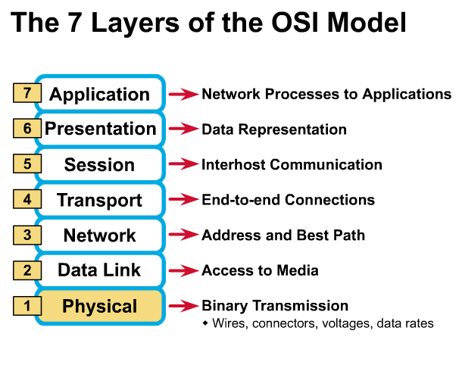
Physical Layer
Determines the specs for all physical components
Cabling
Interconnect methods (topology / devices)
Data encoding (bits to waves)
Electrical properties
Examples:
Ethernet (IEEE 802.3)
Token Ring (IEEE 802.5)
Wireless (IEEE 802.11b)
³

Slide 17
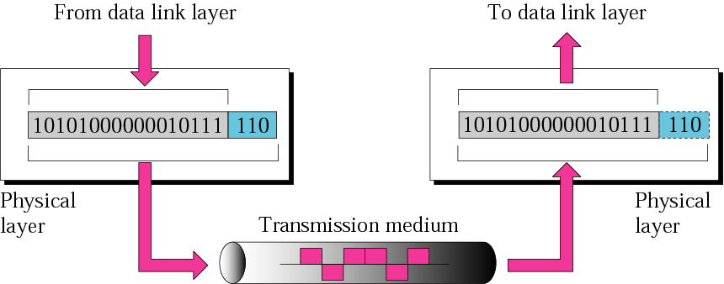
Physical layer
The physical layer is responsible for the movement of individual bits from one hop (node) to the next.

Slide 18
Physical Layer (cont’d)
What are the Physical Layer components on my computer?
NIC
Network Interface Card
Has a unique 12 character Hexadecimal number permanently burned into it at the manufacturer.
The number is the MAC Address/Physical address of a computer
Cabling
Twister Pair
Fiber Optic
Coax Cable

Slide 19
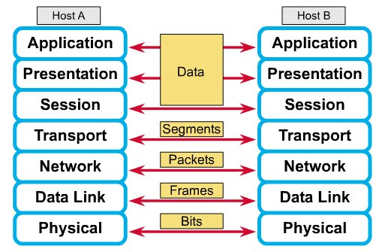
How Does It All Work Together?
Each layer contains a Protocol Data Unit (PDU)
PDU’s are used for peer-to-peer contact between corresponding layers.
Data is handled by the top three layers, then Segmented by the Transport layer.
The Network layer places it into packets and the Data Link frames the packets for transmission.
Physical layer converts it to bits and sends it out over the media.
The receiving computer reverses the process using the information contained in the PDU.
²

Slide 20
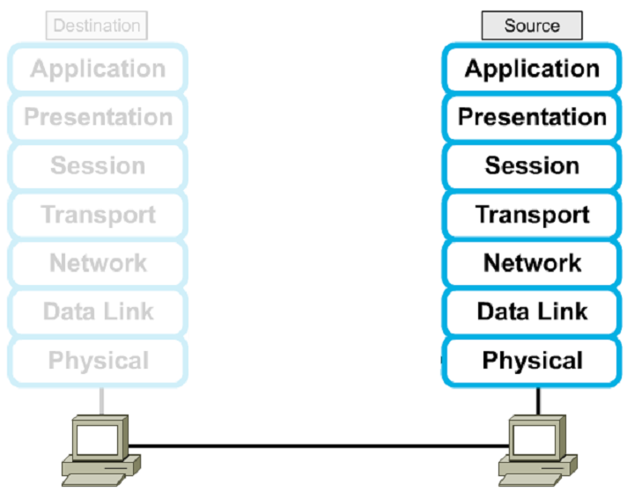




Encapsulation

Slide 21
TCP/IP

Slide 22
TCP/IP model development
The late-60s The Defense Advance Research Projects Agency (DARPA) originally developed Transmission Control Protocol/Internet Protocol (TCP/IP) to interconnect various defense department computer networks.
The Internet, an International Wide Area Network, uses TCP/IP to connect networks across the world.

Slide 23
4 layers of the TCP/IP model
Layer 4: Application
Layer 3: Transport
Layer 2: Internet
Layer 1: Network access
It is important to note that some of the layers in the TCP/IP model have the same name as layers in the OSI model.
Do not confuse the layers of the two models.

Slide 24
The Network Access layer
Concerned with all of the issues that an IP packet requires to actually make the physical link. All the details in the OSI physical and data link layers.
Electrical, mechanical, procedural and functional specifications.
Data rate, Distances, Physical connector.
Frames, physical addressing.
Synchronization, flow control, error control.

Slide 25
The Internet layer
Send source packets from any network on the internetwork and have them arrive at the destination independent of the path and networks they took to get there.
Packets, Logical addressing.
Internet Protocol (IP).
Route , routing table, routing protocol.

Slide 26
The Transport layer
The transport layer deals with the quality-of-service issues of reliability, flow control, and error correction.
Segments, data stream, datagram.
Connection oriented and connectionless.
Transmission control protocol (TCP).
User datagram protocol (UDP).
End-to-end flow control.
Error detection and recovery.

Slide 27
The Transport layer
Allows end-to-end communication
Connection establishment, error control, flow control
Two main protocols at this level
Transmission Control Protocol (TCP),
Connection oriented
Connection established before sending data
Reliable
User Datagram Protocol (UDP)
Connectionless
Sending data without establishing connection
Fast but unreliable

Slide 28
The Application layer
Handles high-level protocols, issues of representation, encoding, and dialog control.
The TCP/IP combines all application-related issues into one layer, and assures this data is properly packaged for the next layer.
FTP, HTTP, SMNP, DNS ...
Format of data, data structure, encode …
Dialog control, session management …

Slide 29
TCP/IP protocol stack

Slide 30
TCP/IP Reference Model
Layer
Protocols
Application
HTTP
TELNET
FTP
SMTP
SNMP
Transport
TCP
UDP
Internet
IP
ICMP
Network Access (Host-to-network)
ETHERNET
PACKET RADIO

Slide 31
Protocols at the Application layer
HTTP:
browser and web server communicatin
FTP :
file transfer protocol
TELNET:
remote login protocol
POP3: Retrieve email
POP3 is designed to delete mail on the server as soon as the user has downloaded it
IMAP (Internet Message Access Protocol )
Retrieve emails,
retaining e-mail on the server and for organizing it in folders on the serve

Slide 32
Protocols at the Transport layer
Transmission control protocol (TCP),
Connection oriented
Connection established before sending data
Reliable
user datagram protocol (UDP)
Connectionless
Sending data without establishing connection
Fast but unreliable

Slide 33
Protocol at the Internet layer
IP
Path selection ,
routing and addressing
ICMP (Internet Control Message Protocol )
sends error messages relying on IP
a requested service is not available
a host or router could not be reached

Slide 34
Protocols at the Network layer
Ethernet
Uses CSMA/CD
Token Ring

Slide 35
Data Formats
Application data
message
Application
layer
Transport
layer
TCP
header
data
TCP
header
data
TCP
header
data
segment
Internet
layer
IP
header
TCP
header
data
packet
Network Access
layer
Ethernet
header
IP
header
TCP
header
data
Ethernet
trailer
frame

Slide 36
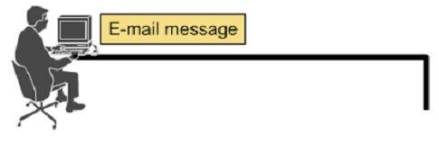




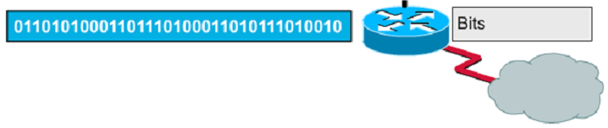
Encapsulation example: E-mail

Slide 37
Protocol Layering Equivalent
Application Layer
Application Layer
Application Layer PDU
Transport Layer
Transport Layer
Transport Layer PDU
Router
Internet Layer
Internet Layer
Internet Layer
IP Datagram
IP Datagram
Network Interface
Network Interface
Network Interface
Ethernet
Frame
Ethernet
Frame
Physical Network
Physical Network

Slide 38
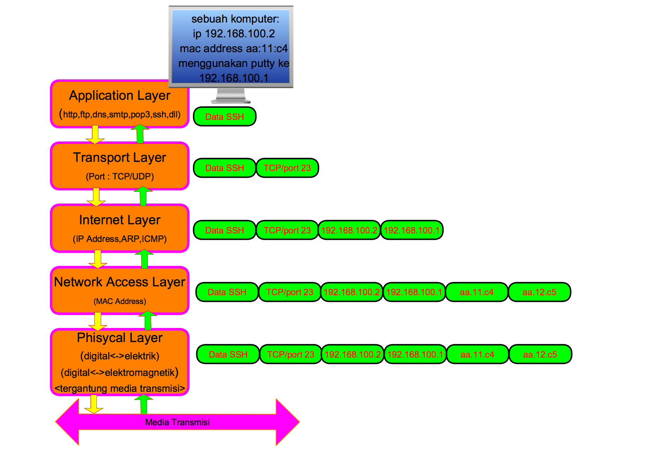

Slide 39
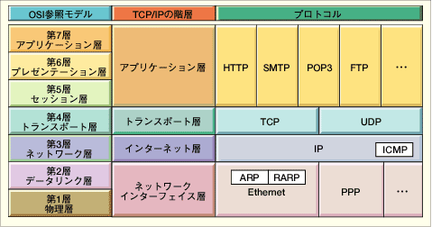
Comparing TCP/IP with OSI
OSI Model
TCP/IP Hierarchy
Protocols
7th
Application Layer
6th
Presentation Layer
Application Layer
5th
Session Layer
4th
Transport Layer
Transport Layer
3rd
Network Layer
Internet Layer
2nd
Link Layer
Network Access Layer
1st
Physical Layer
Net. Access Layer : includes device driver and network interface card
Internet Layer : handles the movement of packets, i.e. Routing
Transport Layer : provides a reliable flow of data between two hosts
Application Layer : handles the details of the particular application

Slide 40
How the OSI and TCP/IP Models Relate in a Networking Environment

Slide 41
Ports in Action
HTTP message
GET index.html
www.localserver.org
HTTP message
Contents of
index.html
192.168.0.20
192.168.0.40
TCP Packet
Src Port: 2076
Dest Port: 80
TCP Packet
Src Port: 80
Dest Port: 2076
IP datagram
Src: 192.168.0.20
Dest: 192.168.0.40
IP datagram
Src: 192.168.0.40
Dest: 192.168.0.20
TELNET message
TELNET message
TCP Packet
Src Port: 2077
Dest Port: 23
TCP Packet
Src Port: 23
Dest Port: 2077
IP datagram
Src: 192.168.0.20
Dest: 192.168.0.40
IP datagram
Src: 192.168.0.40
Dest: 192.168.0.20
switch

Slide 42
Ports
Port 0
Port 1
Port 65535
Each host has 65,536 ports
20,21: FTP
23: Telnet
80: HTTP
A socket provides an interface to send data to/from the network through a port

Slide 43
Port Assignments
Well known ports from 0 to 1023
http=port 80
smtp=port 25
syslog=port 514
telnet=23
ssh=22
ftp=21 + more…
Registered ports from 1024 to 49151
Dynamic or private ports from 49152 to 65535

